Slide 1
HearthStone Card Generator

Slide 2
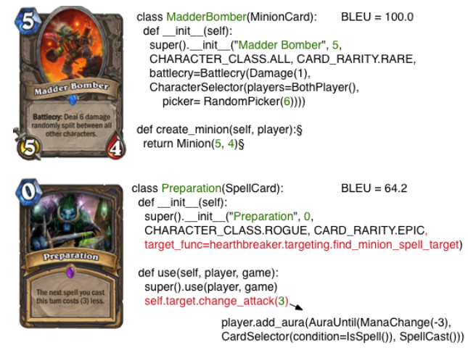
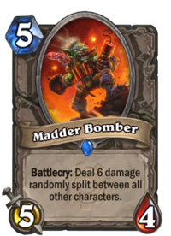
목적

Slide 3
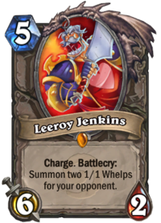
{"artist":"Gabe from Penny Arcade", "attack":6, "cardClass":"NEUTRAL", "collectible":true, "cost":5, "dbfId":559, "elite":true, "faction":"ALLIANCE", "flavor":"At least he has Angry Chicken.", "health":2, "id":"EX1_116", "mechanics":["BATTLECRY","CHARGE"], "name":"Leeroy Jenkins“, "rarity":"LEGENDARY", "set":"EXPERT1", "text":"<b>Charge</b>. <b>Battlecry:</b> Summon two 1/1 Whelps for your opponent.", "type":"MINION"}

Slide 4
{"artist":"Gabe from Penny Arcade", "attack":6, "cardClass":"NEUTRAL", "collectible":true, "cost":5, "dbfId":559, "elite":true, "faction":"ALLIANCE", "flavor":"At least he has Angry Chicken.", "health":2, "id":"EX1_116", "mechanics":["BATTLECRY","CHARGE"], "name":"Leeroy Jenkins“, "rarity":"LEGENDARY", "set":"EXPERT1", "text":"<b>Charge</b>. <b>Battlecry:</b> Summon two 1/1 Whelps for your opponent.", "type":"MINION"}

Slide 5
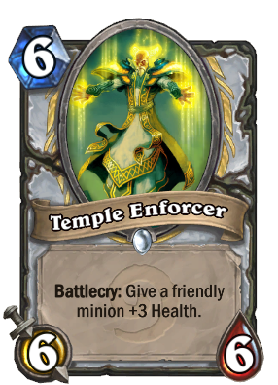
카드 데이터 효과의 분류

